Slide 1

Introduction
Customer Sales Analysis Project Machine Learning and Tableau
Team B
Team Members
Rebecca Marriott
Nouman Mehar
Suneeta Vota

Slide 2
Project – Customer Purchasing
Utilizing data science in ERP systems enables organizations to offer personalized customer experiences. By leveraging customer data, including purchase history, browsing behavior, and demographics, ERP systems can provide insights into individual preferences, allowing organizations to tailor their marketing efforts, offer personalized recommendations, and improve overall customer satisfaction. This targeted approach enhances customer loyalty and drives revenue growth.
Objective
The primary aim of this project is to predict customer Gender based on their shopping behaviors and other relevant features present in the dataset. Leveraging advanced data analysis techniques and machine learning algorithms, we intend to uncover valuable patterns that will facilitate informed decision-making for businesses

Slide 3
DATASET
Customer Information:
Includes customer details like ID, name, email, phone, address, city, state, zipcode, country, age, and gender. Customer segments are categorized into Premium, Regular, and New.
Transaction Details:
Transaction-specific data such as transaction ID, last purchase date, total purchases, amount spent, total purchase amount, feedback, shipping method, payment method, and order status.
Product Information:
Contains product-related details such as product category, brand, and type. Products are categorized into electronics, clothing, grocery, books, and home decor.
Geographic Information:
Contains location details including city, state, and country. Available for various countries including USA, UK, Canada, Australia, and Germany.
Temporal Information:
Last purchase date is provided along with separate columns for year, month, date, and time. Allows analysis based on temporal patterns and trends.
Data Quality:
Some rows contain null values, and others are duplicates, which may need to be handled during data preprocessing. Null values are randomly distributed across rows. Duplicate rows are available at different parts of the dataset.

Slide 4
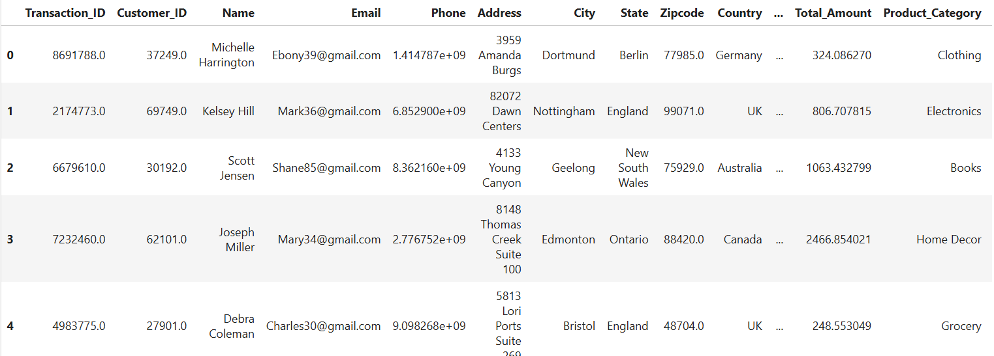

Dataset
Dataset Description:
The dataset represents retail transactional data. It contains information about customers, their purchases, products, and transaction details. The data includes various attributes such as customer ID, name, email, phone, address, city, state, zipcode, country, age, gender, income, customer segment, last purchase date, total purchases, amount spent, product category, product brand, product type, feedback, shipping method, payment method, and order status.
[302010 rows x 30 columns]
Transaction_ID Customer_ID ... Ratings products
0 8691788.0 37249.0 ... 5.0 Cycling shorts
1 2174773.0 69749.0 ... 4.0 Lenovo Tab
2 6679610.0 30192.0 ... 2.0 Sports equipment
3 7232460.0 62101.0 ... 4.0 Utility knife
4 4983775.0 27901.0 ... 1.0 Chocolate cookies
[5 rows x 30 columns]
<class 'pandas.core.frame.DataFrame'>
RangeIndex: 302010 entries, 0 to 302009

Slide 5
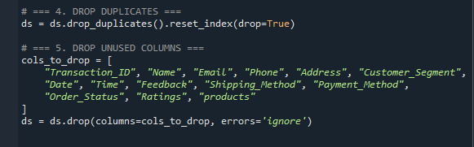
Pre-Processing
For Pre-processing we follow the following steps.
1. Data Collection:
The dataset was sourced from Kaggle, consisting of 302,010 rows and 30 columns.
2. Data Exploration and Understanding:
The initial dataset was printed to understand the structure, including data types, missing values, and duplicates. Duplicate records and irrelevant columns were identified and removed based on domain knowledge and data relevance. After cleaning, the dataset was reduced to 16 columns.

Slide 6
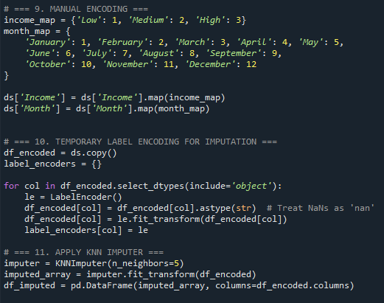
Pre-Processing
3. Handling Missing Data:
Missing values were identified using the isnull() function. To impute the missing values, the K-Nearest Neighbors (KNN) Imputer was employed.
4. Encoding Categorical Variables:
Prior to imputation, categorical variables were encoded as KNN Imputer requires numerical inputs. Manual encoding was applied to columns with a small, manageable number of categories. For the remaining categorical variables, Label Encoding was used to convert them into numeric format.

Slide 7
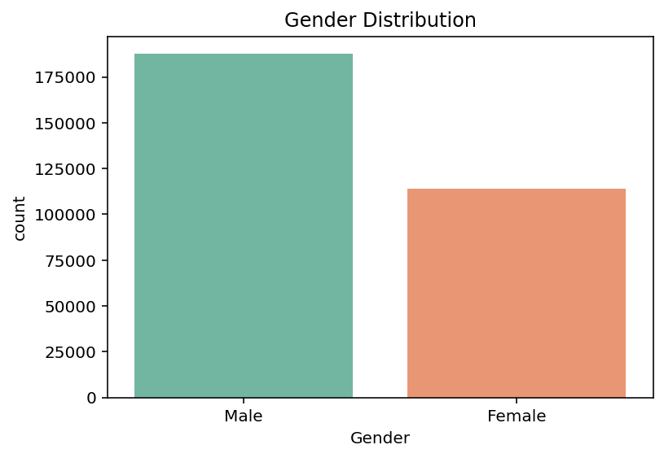
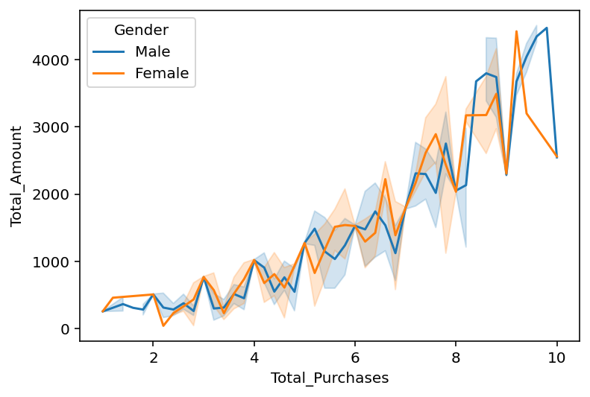
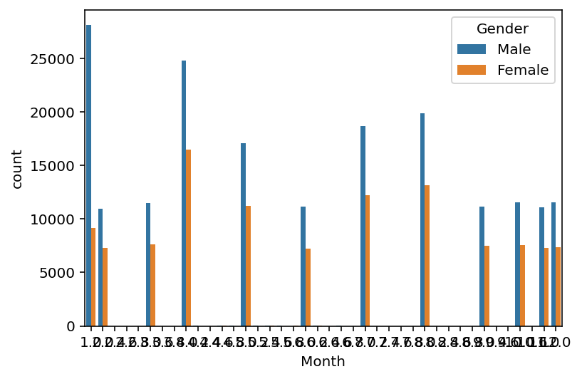
Pre-Processing
5. Decode Back To Original Categories:
Post-processing, the label-encoded categorical columns were decoded back to their original string labels to enhance interpretability during data visualization.
6. Visualization:
Bar Plot
Comparison between male and female customers
Line Plot
Comparison between male and female total purchases
Bar Plot
Comparison between male and female spending's monthly wise

